Slide 1
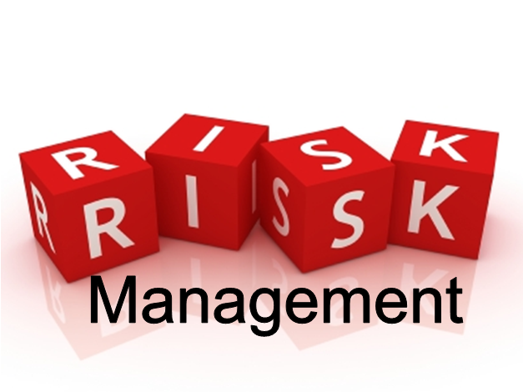
Lecture 7

Slide 2

Lecture Overview
1) Introduction to Risk Management.
2) Importance of Risk Management.
3) Describe the tools and techniques to identify project risks.
4) Prioritize risks using qualitative and quantitative analysis.
5) Explain strategies for dealing with risks.
http://ourkittery.com/wp-content/uploads/2014/03/Lectures.jpg

Slide 3
What is risk in design?

Slide 4
Risk can be defined as the probability or threat of damage, injury, liability, loss, or any other negative occurrence that is caused by external or internal vulnerabilities, and that may be avoided through preemptive action.
A “risk” can be identified. It is known.
A risk is not an uncertainty
An “uncertainty” is when neither the probability nor the mode of occurrence is known. If you don’t know about it, you can’t take preemptive action to address it.
http://www.businessdictionary.com/definition/risk.html

Slide 5
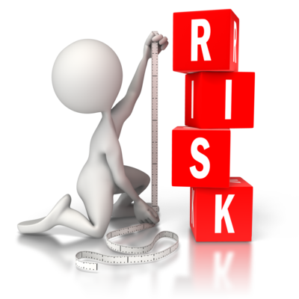
How is Risk Defined?
Any event that can negatively affect the viability of a project.
Risk comes in many sizes and shapes. The idea about risk management is to minimize the impact of the negative event. In order to do that the project team has to follow these steps:
identify the possibility for a risk event
rate the probability and impact of this event
find solutions to deal with this event
Document solution

Slide 6
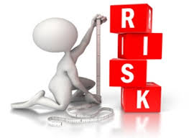
What is risk analysis?

Slide 7
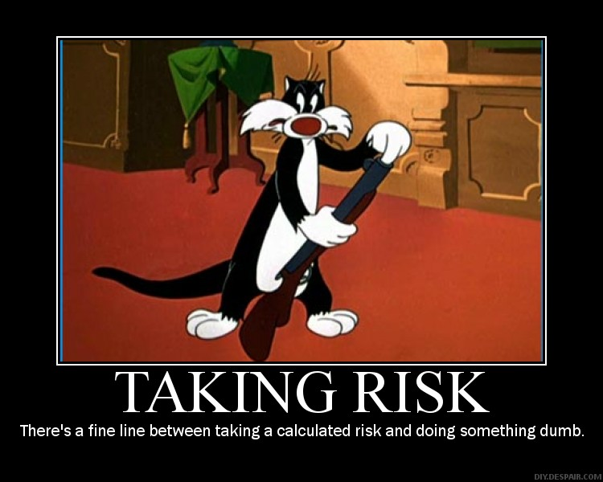
Project Risk is based on this simple equation:
Risk = Probability of event x impact of event
So, any risk events have to be evaluated in two terms. The likelihood for the event to happen (usually in Percent) and the impact the event will have ($, time delay).
http://blog.hedgebookpro.com/wp-content/uploads/2012/06/risk-taking-2.jpg

Slide 8
Risk analysis is the process of defining and analyzing the dangers to individuals, businesses and government agencies posed by potential natural and human-caused adverse events
Divide risk analysis into two components:
Risk Assessment: Identifying, evaluating, and measuring the probability and severity of risks
Risk Management: Deciding what to do about the risks once they have been identified
https://en.wikipedia.org/wiki/Risk_analysis

Slide 9
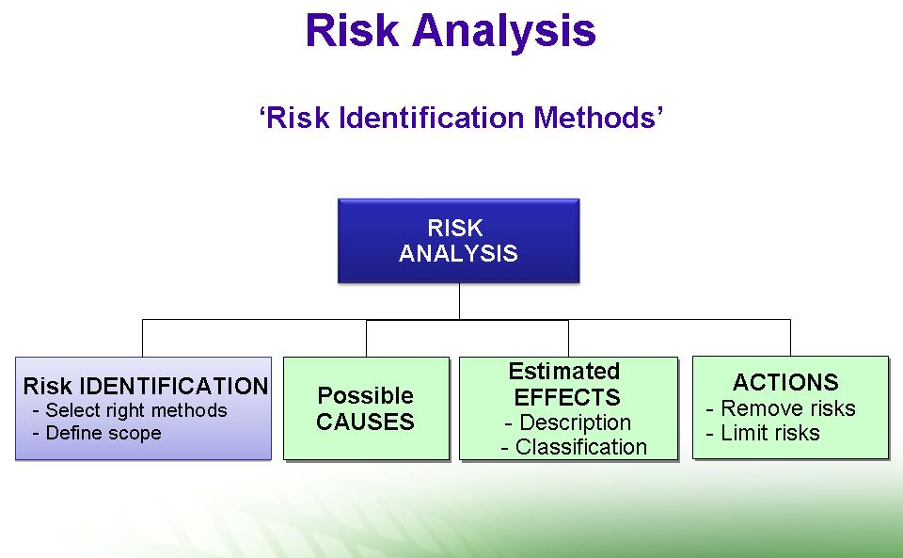

Slide 10
When to use risk analysis…
Risk analysis is useful in many situations:
When you're planning projects, to help you anticipate and neutralize possible (IDENTIFIED) problems
When you're deciding whether or not to move forward with a project
When you're preparing for adverse events such as component failure
When you're planning for changes in your environment, such as new competitors coming into the market, or changes to government policy.
https://www.mindtools.com/pages/article/newTMC_07.htm

Slide 11
Risk analysis is a fundamental part of a company’s risk management strategy

Slide 12
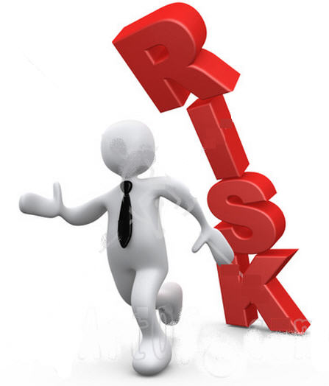
Goal of Risk Management
The goal is to minimize the exposure of the company to the unpleasant outcome of the risk event.

Slide 13
Risk management is the identification, assessment, and prioritization of to minimize, monitor, and control the probability and/or impact of unfortunate events.
There are two types of events
Negative events can be classified as risks
Positive events are classified as opportunities
https://en.wikipedia.org/wiki/Risk_management
FMEA is a very good tool to use for risk management

Slide 14
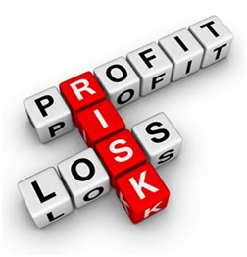
Side Note: Risk and Opportunity
Risk and opportunity are mirror images of unforeseen project events. Opportunity has a positive outcome to the project while risk has adverse effects on the project.
Opportunities are best handled outside of the Risk Management process. The same methods apply, just for a different outcome.

Slide 15
Risk Management
Risk Management is a four-stage process:
Risk Identification The process of determining the specific risk factors that can reasonably be expected to affect your project
Analysis of the probability and consequences The potential impact of these risk factors, determined by how likely they are to occur and the effect they would have on the project if they did occur.
Risk mitigation strategies Steps taken to minimize the potential impact of those risk factors deemed sufficiently threatening to the project.
Control and Documentation Creating a knowledge base for future projects based on the lessons learned

Slide 16
1) Risk Identification and classification
Starts by classifying the risk into one of the following classes of risk:
Financial
Technology
Resources
Schedule
Weather
Political
Environmental
Note this list is not a complete list. It represents the most common risk associated with most projects.

Slide 17
2) Analysis of Probability and IMPACT
The next step is to assign a reasonable value to the probability and impact the risk has. There are two ways to do it: - Team assessment - Quantitative method
We can construct a risk impact matrix (likelihood on x axis, impact on y, low medium high right top).

Slide 18
Team Assessment Risk Analysis
1) Data Gathering and Representation techniques
Interviewing to quantify the probability and impact of risks on project objectives. The information gathered depends on the circumstance, but most likely will include the optimistic (low), pessimistic (high), and most likely scenarios for the risk event.
Probability distributions can be used to represent uncertain events, such as the outcome of a test.
Expert judgment, experts validate data and techniques.

Slide 19
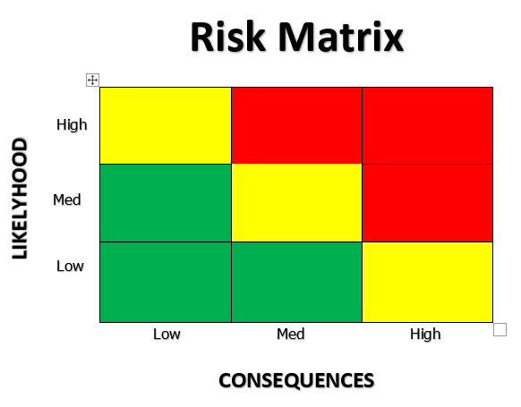
Red Risk: highest impact potential, a plan has to be worked out in advance of the event from happening to mitigate the effects…
Yellow Risk: usually a team decision if a mitigation strategy has to be in place…
Green Risk: be aware....

Slide 20
Quantitative Risk Analysis
Tools and Techniques for quantitative risk analysis:
2) Quantitative Risk Analysis and Modeling Techniques
Sensitivity Analysis helps to determine which risks have the most potential impact on the project. It examines the extent to which the uncertainty of each project element affects the objective being examined when all other uncertain elements are held at their baseline values.
Expected monetary value analysis (EMV) analysis is a statistical concept that calculates the average outcome when the future includes scenarios that may or may not happen. EMV is calculated by multiplying the value of each possible outcome by its probability of occurrence, and adding them together. This is usually done in a decision tree analysis.

Slide 21
2) Quantitative Risk Analysis and Modeling Techniques
Decision tree analysis is usually structured using a decision tree diagram that describes a situation under consideration and the implications of each of the available choices and possible scenarios.
Modeling and Simulation. Here the Monte Carlo technique is typically used, this iterative process is usually performed by a computer that calculates the outcomes of a set of events with the input of randomized values from a probability distribution function. A probability distribution is calculated.

Slide 22
Building your summer Cottage
Is it better to buy copper wiring and water piping now, or wait until the
summer, when it needs to be installed saving the storage cost?
A total of 750 lbs of copper have to be purchased.
Storage cost is $100.00
What type of risk are we evaluating?
FINANCIAL

Slide 23
Assumptions
Copper will cost $5.58 / lb in the summer, 90% guaranteed.
Copper will cost $4.50 / lb in the summer, 10% probability
Storage cost for the timeframe: $100.00
Buy now or buy later?

Slide 24
Expected monetary value analysis (EMV)
90%
High Copper Price
$4185.x90%=$3766.50
$5.58/lbx750lb=$4185.00
Buy later
10%
Low Copper Price
$3375.x10%=$337.50
Buy now or later?
$4.50/lbx750lb=$3375.00
EMV for “Buy later” is $4104.00
100%
Buy now
$4285.00
($5.58/lbx750lb+$100.)x100%=$4285.00
EMV for “Buy now” is $4285.00
With these assumptions it is better to buy the wiring and piping later

Slide 25
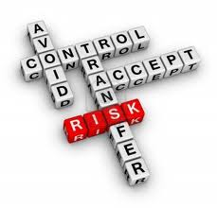
3) Risk Mitigation Strategies categorization
The next stage in risk management is the development of effective risk
mitigation strategies.
There are six possible alternatives a project organization can adopt to
address risk:
Accept Risk
Minimize Risk
Share Risk
Transfer Risk
Contingency Reserve
Other strategies

Slide 26
a) Accept Risk
One option that a project team must always consider is whether the risk is sufficiently strong that any action is warranted. Any number of risks of a relative minor nature may be present at any point in time. However because the likelihood of their occurrence is so small or the consequences of their impact are so minor, they may be judged acceptable and ignored.
For example the record industry spends millions every year in developing, producing, and promoting new recording artists. Knowing full well that less than 5% are profitable. Hence, a high degree of commercial risk is embedded in the system itself and must be accepted in order to operate in the industry.

Slide 27
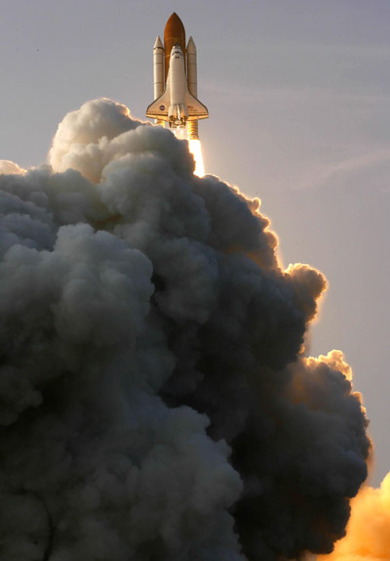
Repairing Endeavour is too risky, says NASA
12:59 17 August 2007
New Scientist Space and Reuters
A small, deep gash in space shuttle Endeavour's heat shield poses no threat to the ship and does not need repair, NASA said on Thursday after studying the problem for nearly a week.
NASA officials considered sending astronauts out to patch the 8-centimetre (3-inch) gash in the shuttle's belly, but decided Endeavour was all right and it was better not to interfere with the heat shield, mission management team chairman John Shannon said.
"[The hole] does not constitute a risk to the crew, it is not expected to cause any damage to the vehicle structure," he said in a briefing at Johnson Space Center in Houston, Texas, US. "You have something you know you can live with, why would you take the risk of the [spacewalk] to change that?"

Slide 28
b) Minimize Risk
Strategies to minimize risk are the next option.
Consider the Dash 8 mid-range turboprop airplane build by Bombardier.
Each aircraft contains millions of individual parts , most of which must be acquired from vendors. The risk for the plane if one of the parts malfunctions is too great. Therefore most aircraft manufacturers insist that all significant vendors maintain direct contact with the companies quality department.
The aircraft companies also insist on interfering with the production process in order to ensure that the resulting quality meets expectations. But because the company cannot manufacture all parts of an aircraft, they seek to minimize risk through supplier selection, quality standards and audits.

Slide 29
c) Share Risk
Risk may be allocated proportionally among multiple members of the project.
Two of the examples of sharing risk is the research and development done through the European Space Agency (ESA) and the Airbus consortium. Due to the tremendous barriers to entry, no one country in the European Union has the capital resources and technical skills to undertake the development of the Ariane rocket for satellite delivery or the creation of a new airframe to compete with Boeing.
ESA and Airbus partners from a number of countries have jointly pooled their resources and at the same time, agreed to jointly share the risk inherent in the venture.

Slide 30
d) Transfer Risk
In some circumstances, when it is impossible to change the nature of the risk, it may be possible to shift the risk to another party.
For example a good method to prevent excessive budget overruns is a fixed-price-contract. They establish a price upfront, should the project slip, the vendor must carry the full burden of the overrun.
Alternatively, if the goal is to ensure functionality (quality and performance), the concept of liquidated damages is used. Liquidated damages represent project penalty clauses that kick in at mutually agreed-on points in the development and implementation.

Slide 31
e) Use of Contingency Reserves
Contingency reserves are among the most common methods to mitigate risks.
They are defined as the specific provision for unforeseen elements of cost within the defined project scope. In construction projects it is not uncommon to set aside 10-15% of the construction price in a contingency fund.
In other fields, however, this practice is not done, due to the fact that the team might fear that the customer or management might see it as a sign of poor planning or inadequate scope definition.

Slide 32
e) Use of Contingency Reserves
There are two types of contingencies:
Task Contingency is used to offset schedule overruns, budget cuts or other unforeseen circumstances accruing to individual tasks or work packages. These budget reserves are managed by the project manager. Naturally, as the project moves forward, it may be possible to reduce budget reserve requirements for task contingency because of the progression of the work. As a task is completed, the reserve left for that task cannot be accessed anymore.
Managerial Contingency is an additional safety buffer applied at the project level. They are used in instances where the customer changes the scope half way through the development process. "Acts of God", natural disasters or the like are unforeseeable by definition. In these cases Management (not the project manager) has access to this contingency fund.

Slide 33
What is FMEA?

Slide 34
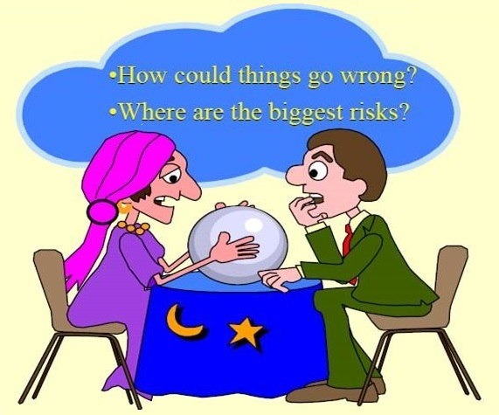

Slide 35
FMEA is often the first step of a system reliability study. It involves reviewing as many components, assemblies, and subsystems as possible to identify failure modes, and their causes and effects.
FMEA helps identify potential failure modes based on experience with similar products.
“Failure Mode” refers to identifying what can fail and how it will or might or could conceivably fail.
“Effects Analysis” refers to studying the consequences of those failures.
https://en.wikipedia.org/wiki/Failure_mode_and_effects_analysis

Slide 36
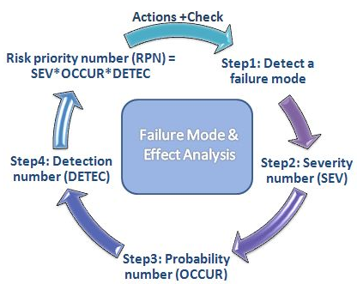

Slide 37
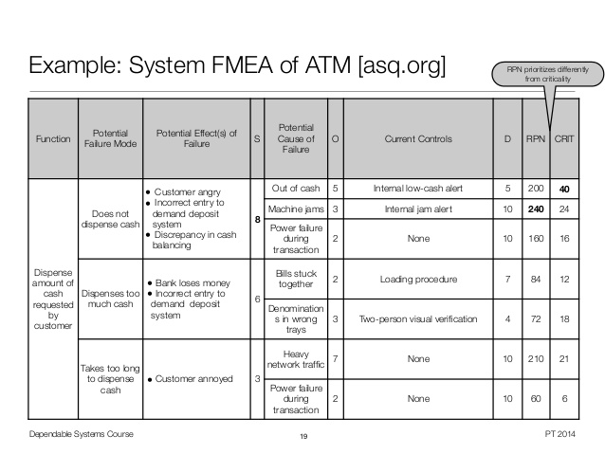
FMEA…

Slide 38
Group Work
In your Project Groups discuss the Risks associated with the following project.
You and five friends are going to borrow a friend's car and drive to the beach. You have never been to this beach before and you are uncertain of the directions to get there. One of your friends is a very picky eater and you were planning on having lunch and dinner at the beach. The weather has been unpredictable the last few days and the forecast calls for a mix of sun and clouds with a chance of rain and high winds. The car that you are going to borrow is an older car and your friend has said that he is going to replace it soon due to issues that he is having with it. You are considering buying it so this is a good chance to try it out. This beach is very popular, and you have heard that there is going to be a fireworks show on the beach after sunset and music all day at a stage setup on the beach.
List all the risks that you can think of for the given scenario. Classify the risks into one of the categories discussed earlier and identify what strategy you would use to mitigate the risk.

